Slide 1
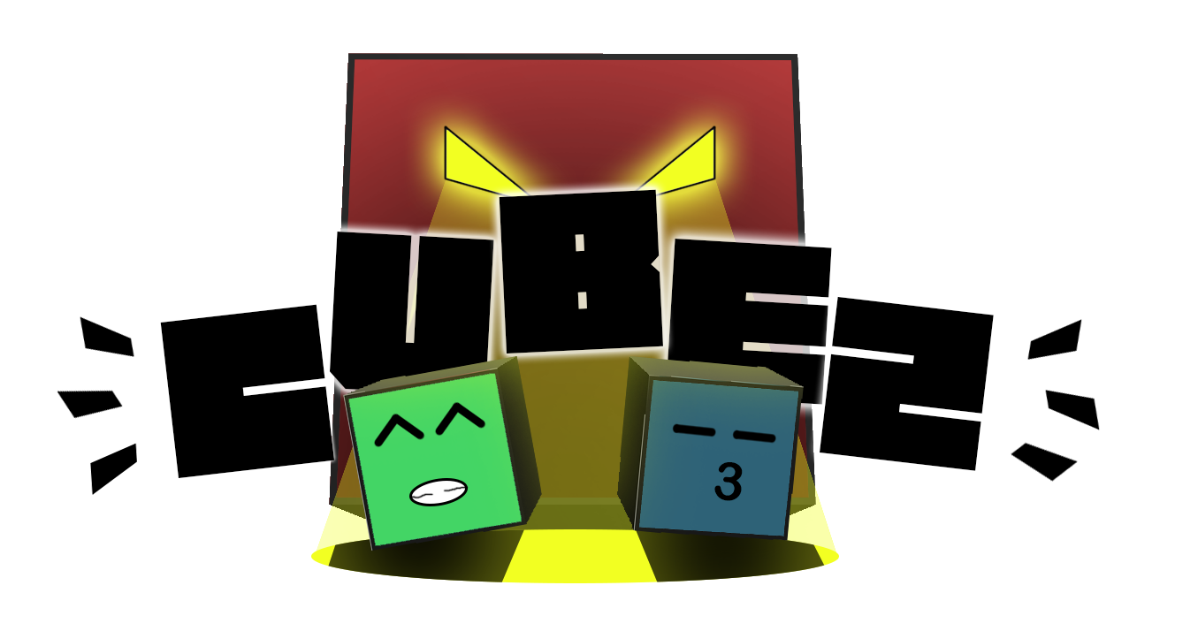
The game
Notes:
Intro : Presentation
Talk to you about CubeZ and this was the logo for the game

Slide 2

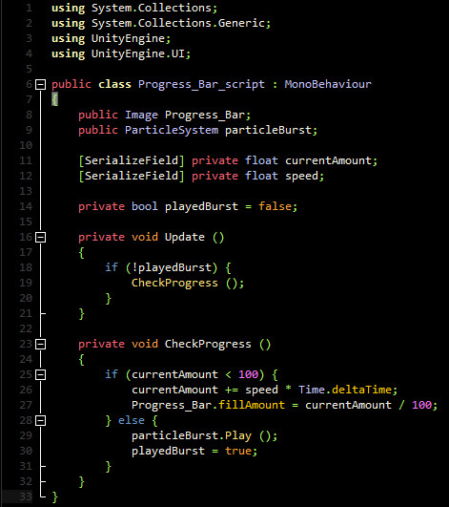
5 Game Designers + 3 Programmers
Notes:
4 Game designers
3 Game Programmers
Our first time working with programmers
Interesting to learn their problematics and see our game design ideas getting implemented in the game

Slide 3
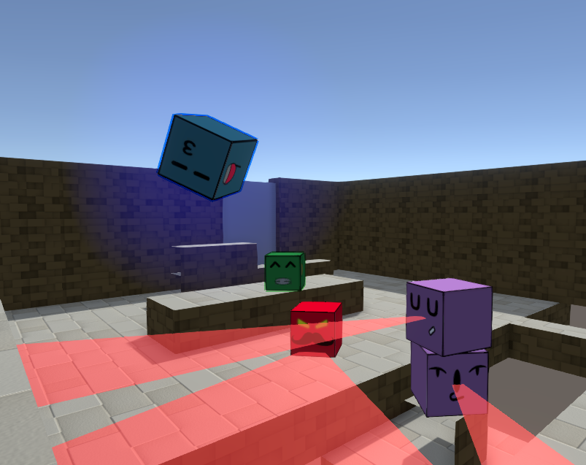
Concept
Notes:
2 avatars that have the same abilities
You can only control one at a time
So you could separate them to do one thing on one side of the map and the other one on the other side

Slide 4
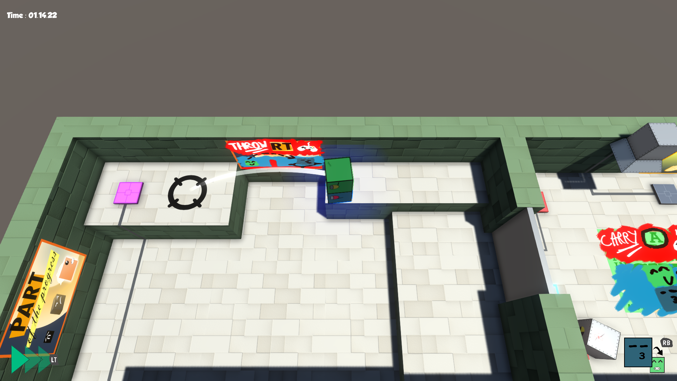
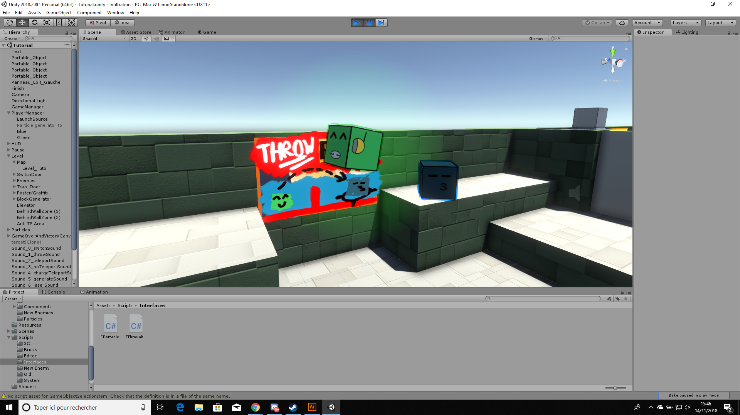
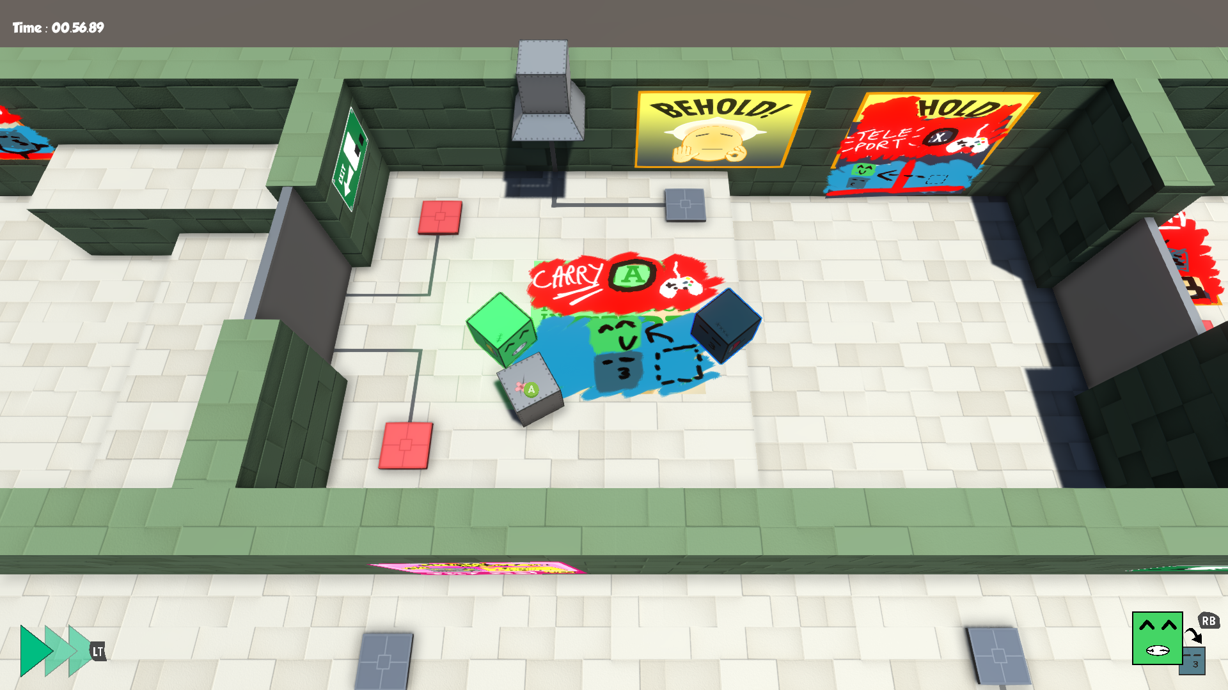
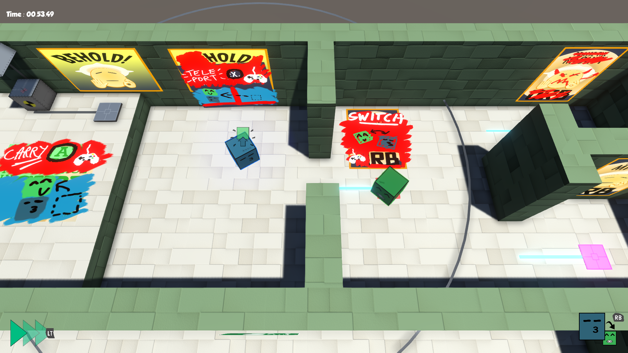
Mechanics
Notes:
Carrying and throwing the other avatar or boxes
Teleport the inactive avatar on you

Slide 5
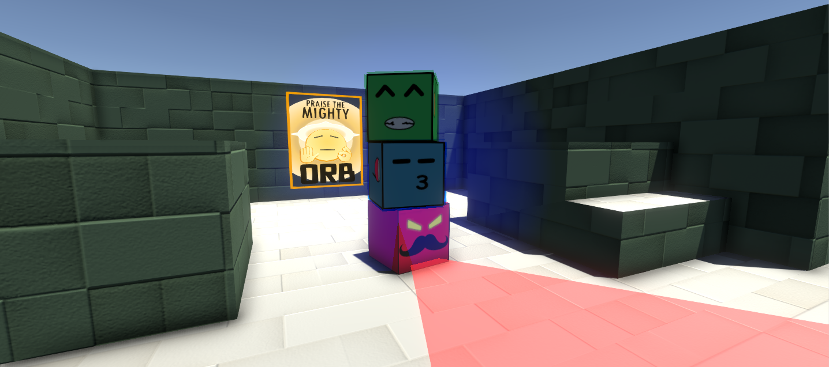
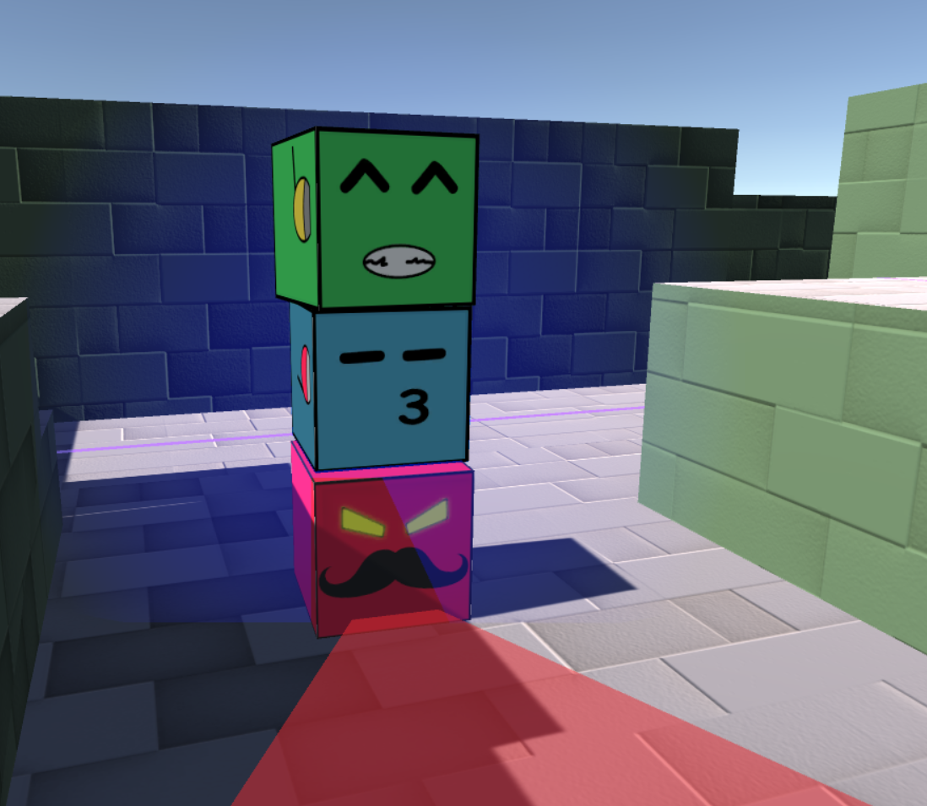
Just cubes…?
Notes:
Everything was made out of cubes so that you could have stacks of cubes, floors the exact right size of the cubes. And you could walk on an enemy’s head and climb on platforms etc
It was pretty difficult to implement according to the programmers

Slide 6
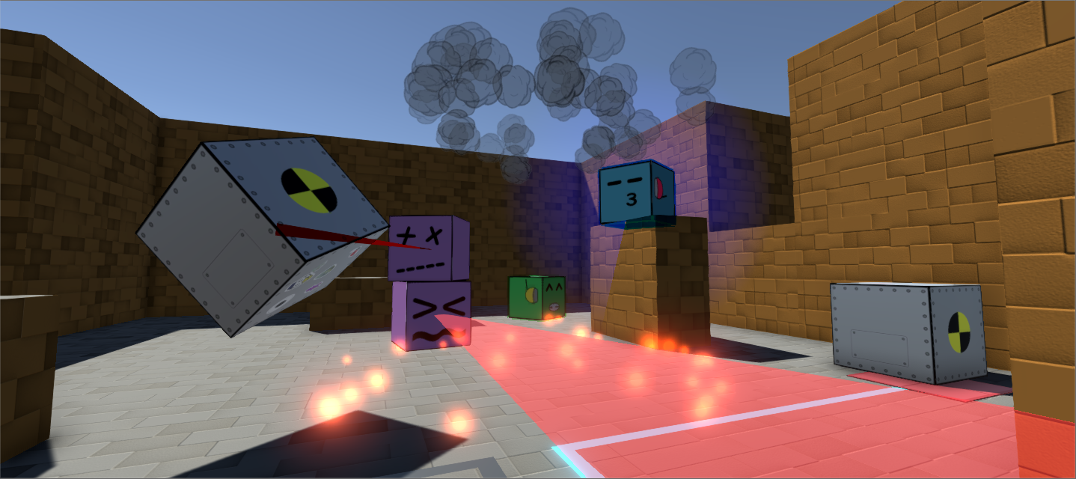
Immersive Sim
Notes:
Everything interacts with everything and there is a understadable logic in the interactions between all the elements of the game

Slide 7
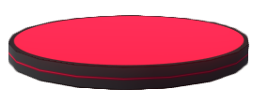


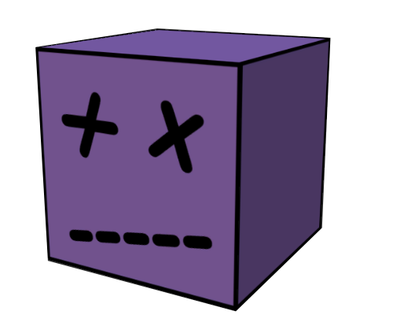

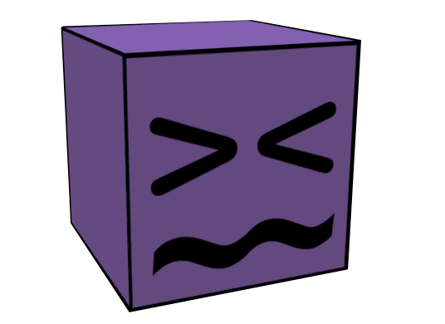
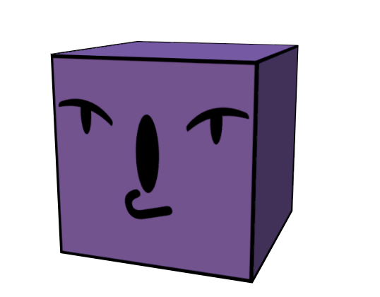
Enemies
Notes:
Red cubes are simple enemies and walk around trying to catch you
The flying disk flies above the map and sees in a cone below it
The purple cubes don’t walk around but they stack up and create turrets that can see on different floors

Slide 8

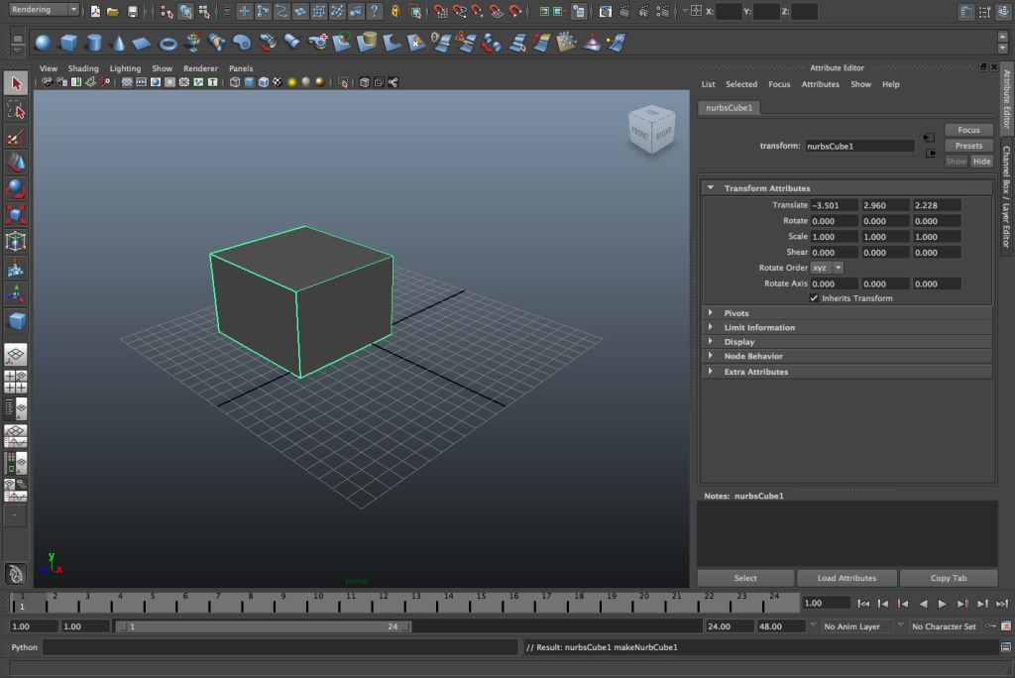
Notes:
Learn how to use Maya a 3d modeling program
First time using 3D program and trying to get things done with it
Learning all the problematics to implement your 3D models in the game

Slide 9
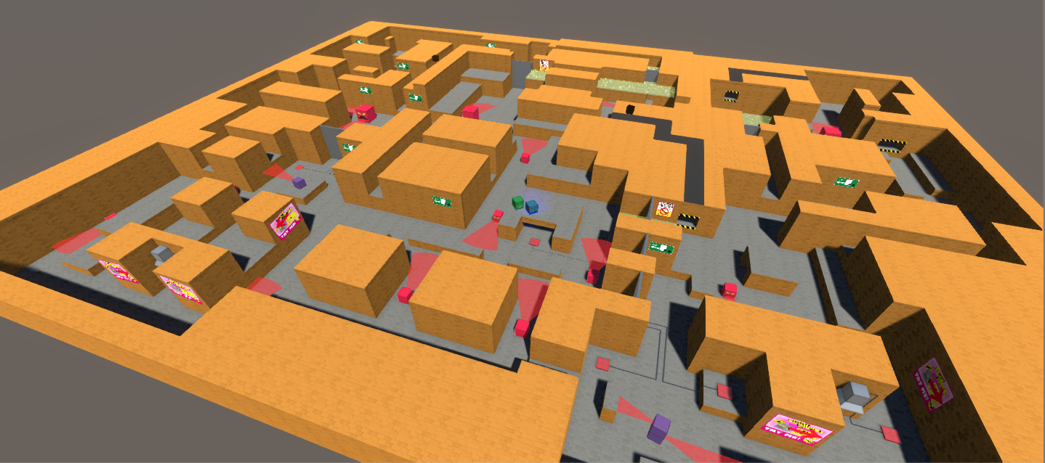
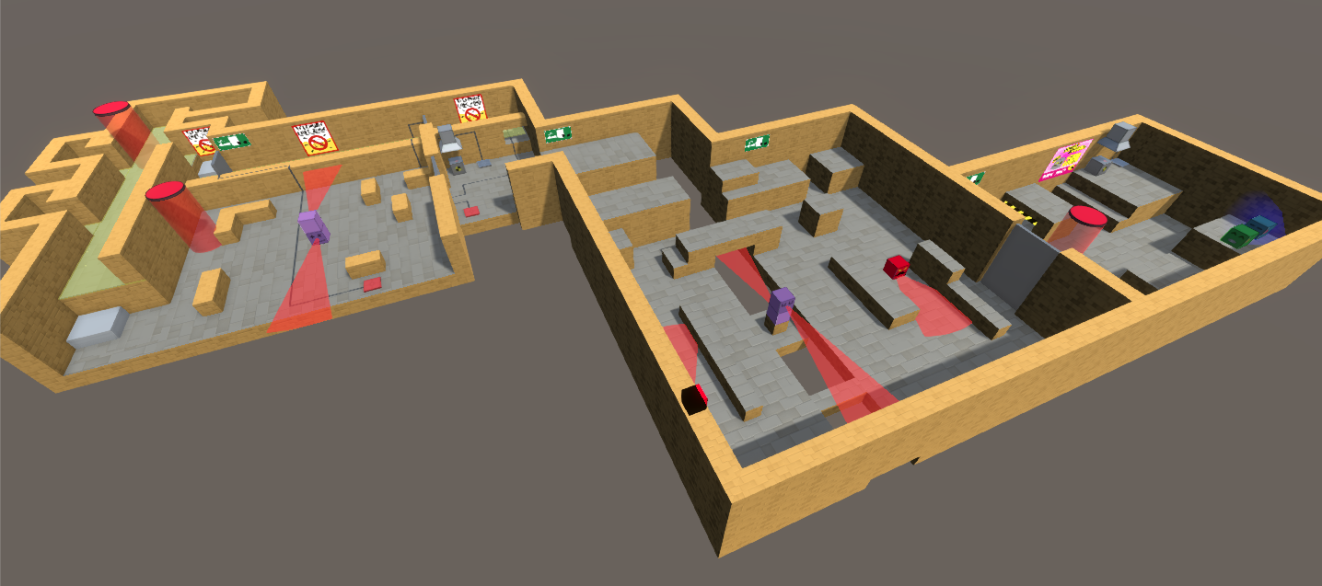
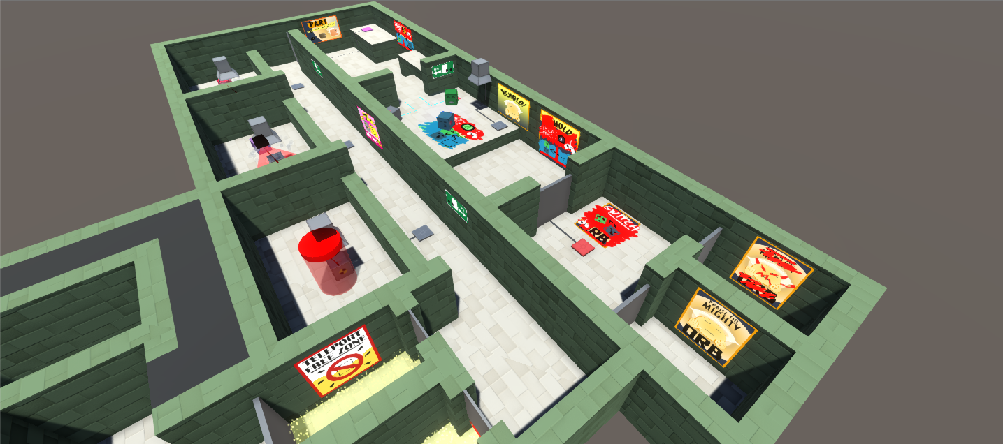
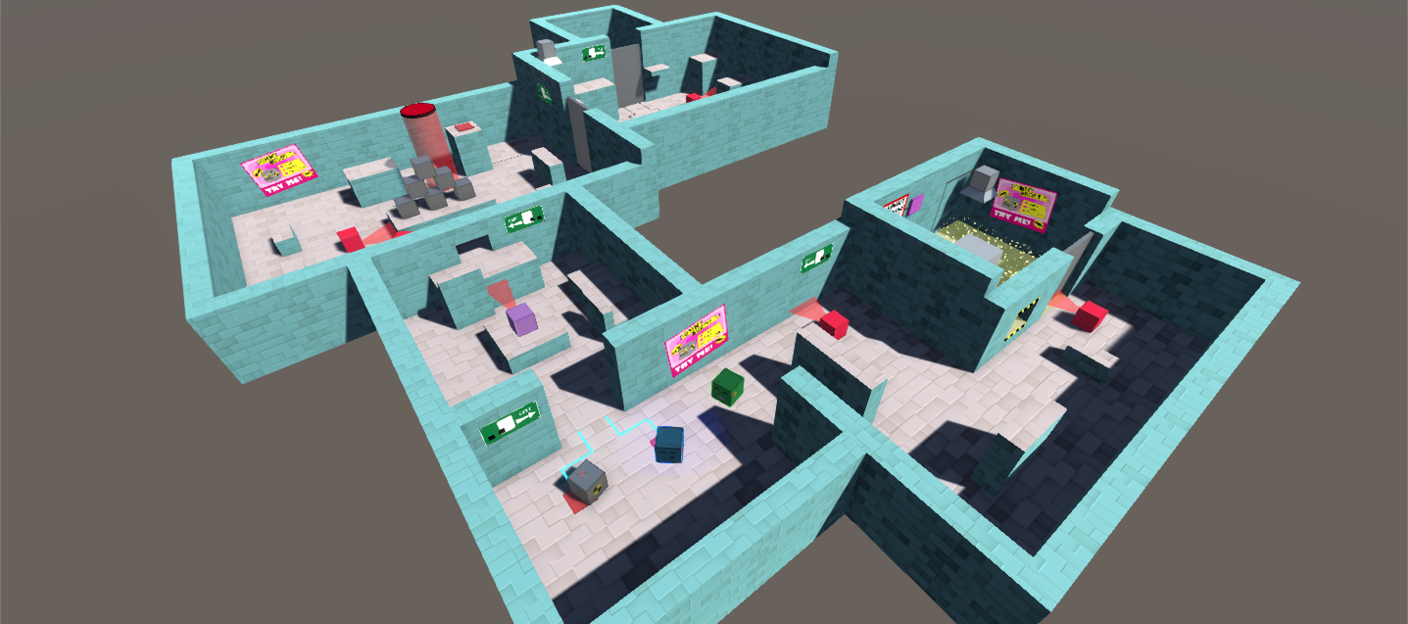
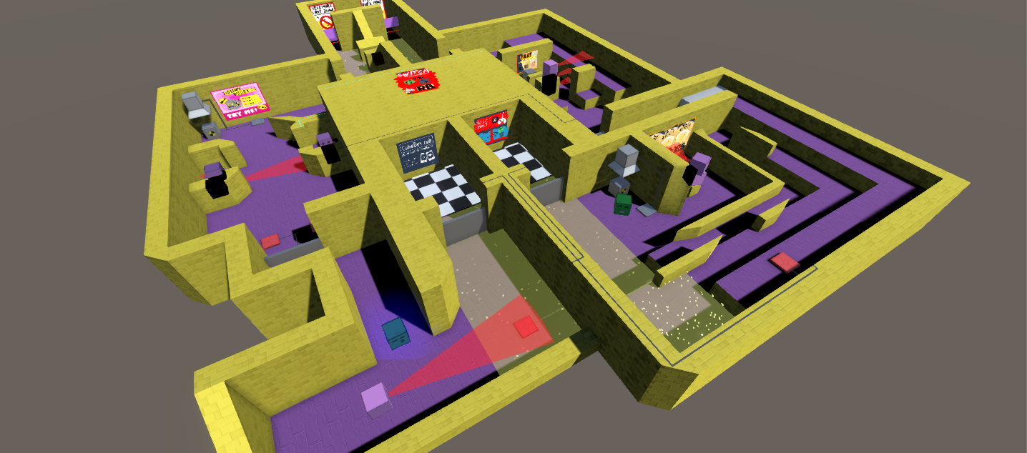
LEVEL
DESIGN
Notes:
Screen de chaque lvl

Slide 10
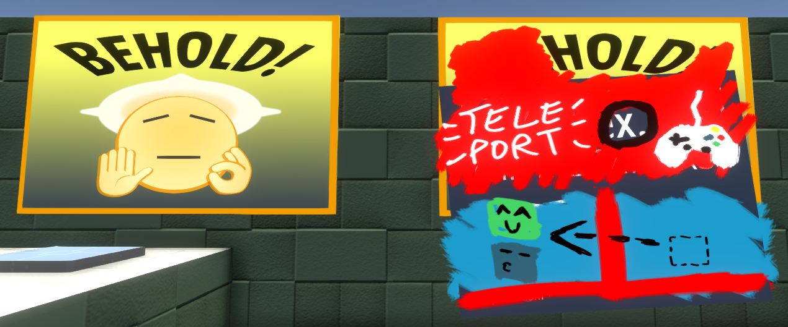
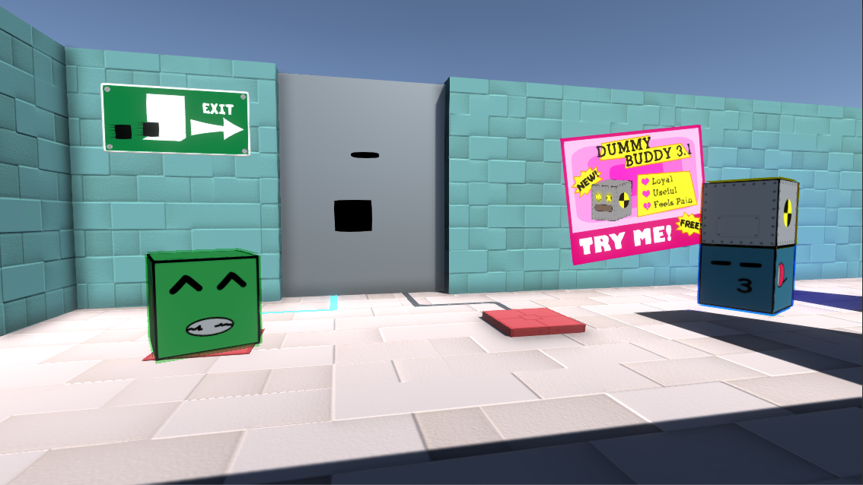
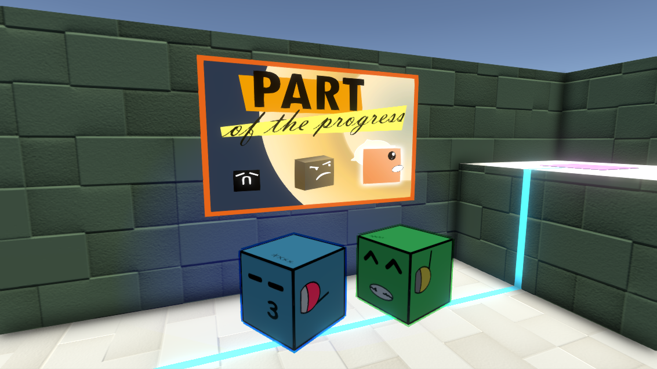

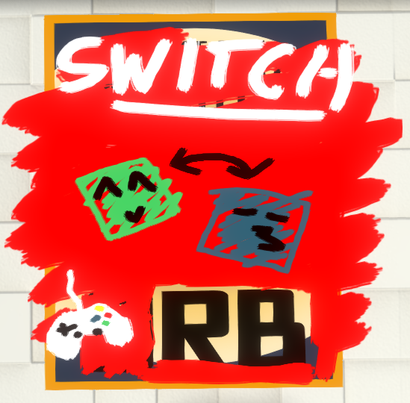
Art
Style
Notes:
Cartoony style
Posters for lore
Graffitis to teach mechanics

Slide 11

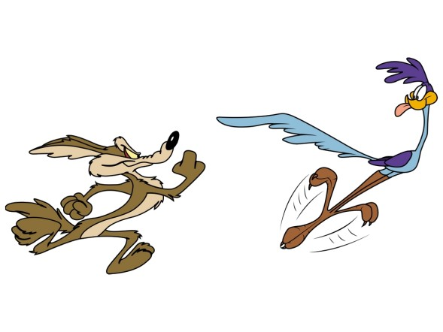
Sound design
MUSIC
SFX
Jazz
Cartoon
Notes:
Musique jazzy espion SFX débiles cartoon

Slide 12
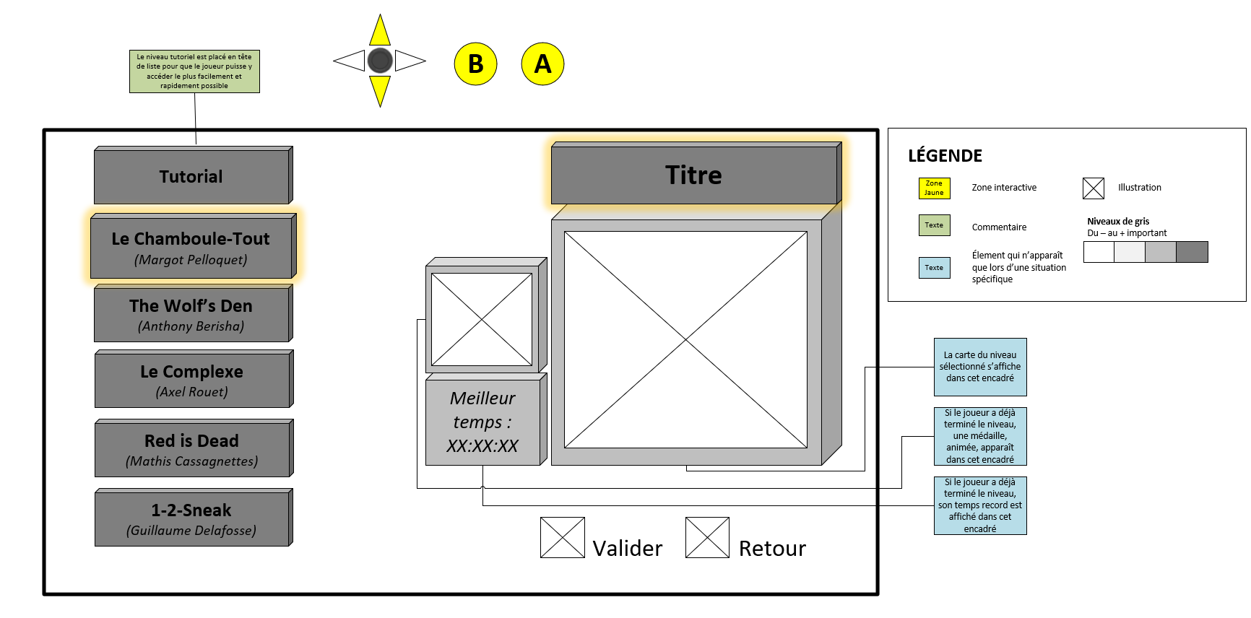
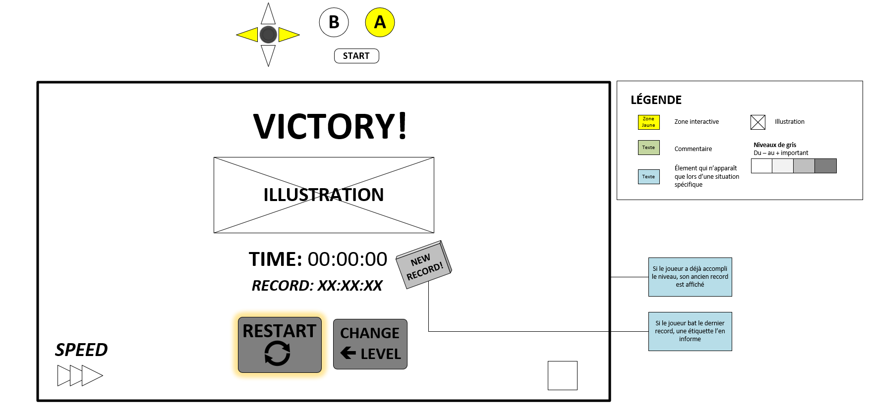
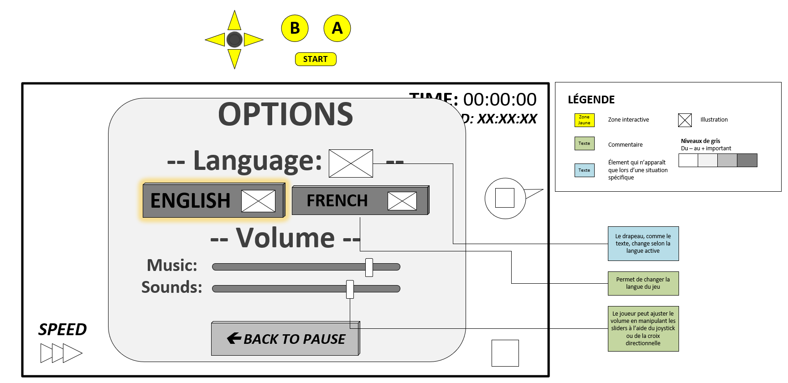
Wireframe
Notes:
Screens des wireframes

Slide 13
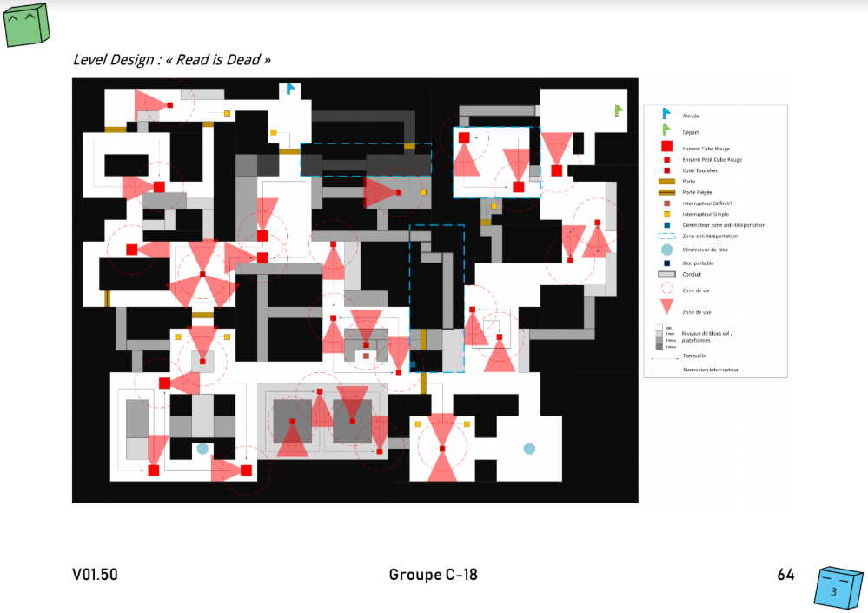
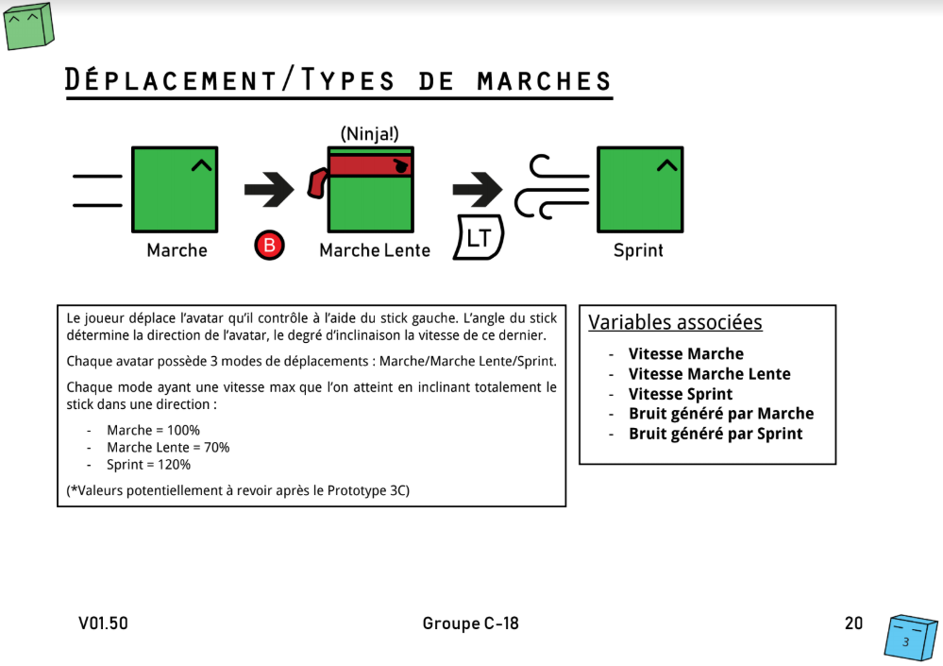
Game Design Document
Notes:
Screens du gdd

Slide 14
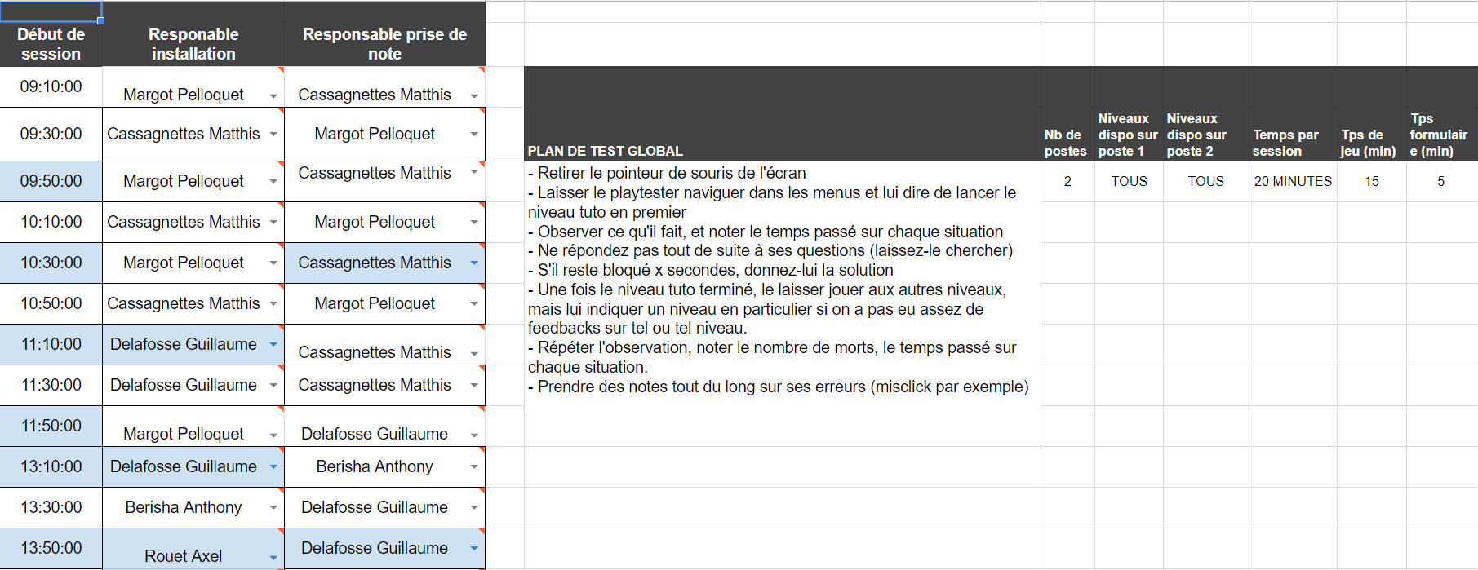
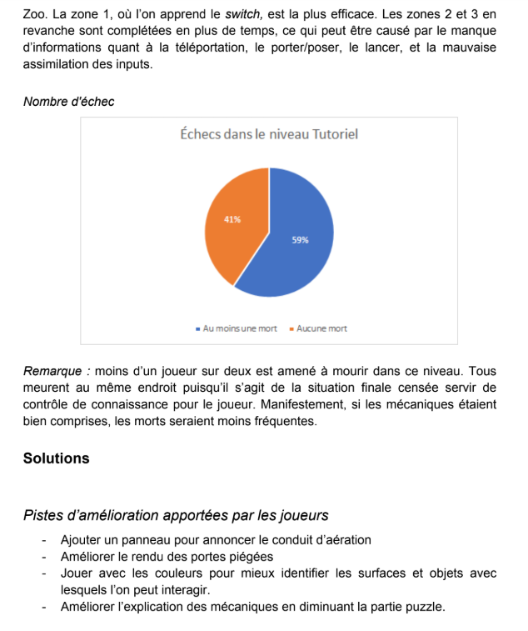
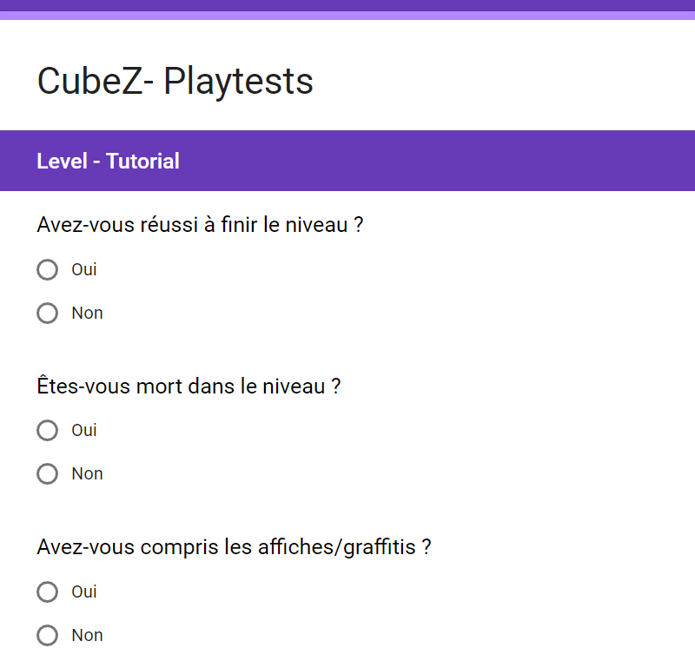
The importance of Playtesting
Notes:
Parler des playtests ⇒ Screenshots de doc de playtests
Pb rencontrés au niveau des contrôles et de la logique des mécaniques etc

Slide 15
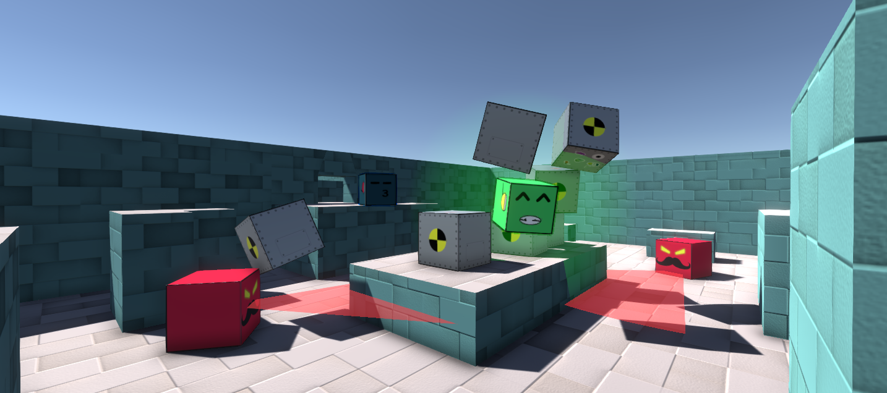
Fun facts
Notes:
Réfléchir à des fun facts en plus des tricks qu’on voulait faire

